Slide 1
Enterprise Data Lake Framework
TCS-GE Digital Analytics, Big Data and Information Management
TCS Confidential

Slide 2
Enterprise Data Lake Framework - Our Methodology for success
Initiate - Art of Possible
Determine KBDs & KPIs
Scope the Data
Architect Future State
Roadmap & Maturity Model
Implement
Framework ?
Technology agnostic roadmap to data lake.
A set of foundational structures.
A set of building blocks and their relationships.
A detailed method and a set of supporting tools.
A common vocabulary.
A list of recommended standards.
A list of best practices and compliant products.
Advantages
Improved productivity
Higher ability to deliver right first time
Lower design/development time and cost
Improved ability to address critical aspects
Reduced complexity and risk
Improved interoperability and extensibility
TCS Confidential

Slide 3
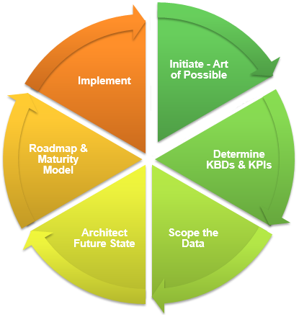
Phase 1 – Initiation activities to meet the business directive for new EDL.
Scope the Impact
Understand Current State
Governance & Support
Identify hard units – Affected most & Achieve most
Identify soft Units – Not directly affected but see a change in work
Identify external units – Outsiders but will be affected
Identify regulators – Legal and Geographies
Determine existing capabilities
Identify proposed/potential changes and gaps
Identify common areas of interest and conflicts
Identify productivity & collaboration tools
Allocate key roles & responsibilities
Identify elements of governance
Create & agree on governance & support model
Objective
Determine and establish the desired capability.
Understand the context
Identify the scope of the units affected
Identify processes and methods that intersect with the new capability.
Define and establish resources and process for governance.
EDL Model Document
Scope of Enterprise
Impact on units and process model
Gaps, Resolution approach & Targets
Team organization, Roles & Responsibilities
Governance & support strategy
TCS Confidential

Slide 4
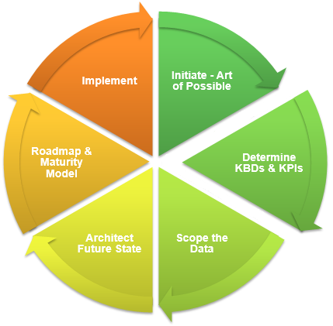
Phase 2 – Describe various aspect of business environment
Identify KBDs
Create service models
Impact Analysis
Identify key business drivers and stakeholders
Identify relevant business viewpoints (Operations, management, financials)
Identify KPIs for success and performance measurement.
Create business interaction & Information exchange matrix
Create business process models and diagrams
Develop baseline description of existing service models
Develop a target description of service models
Perform Impact analysis to understand any wider impacts or implications.
Conduct a stakeholder review to validate against original motivation for the services.
Document requirements traceability report
Objective
Determine and establish business architecture.
Describe how the enterprise needs to operate to achieve the business goals and develop the target product and service strategy and the organizational, functional, process, information, and geographic aspects of the business environment.
BRD Document
Business goals and objectives
Baseline Business Services & Target Business Services
Org structure with locations and units & decomposed business functions
Business requirements, processes, measures, constraints (NFRs) and deliverables
Business roles, including development and modification of skills requirements
Viewpoint models and diagrams to address stakeholder’s concerns
TCS Confidential

Slide 5
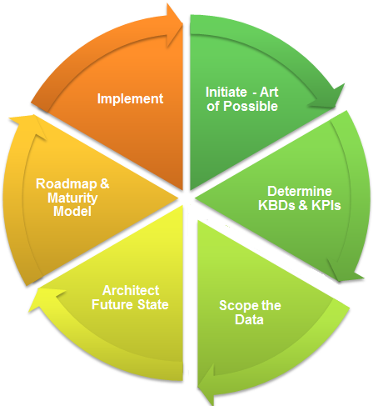
Phase 3 – Develop a data architecture that enables business objectives
Scope the data
Develop architecture
Build the roadmap
Create a data catalog tracing from business functions to data entities.
Map data entity with business function (which data supports which business function)
Map data entity with applications (which application consumes/generates which entity)
Scope the data viewpoints (regulators, generators, consumers, auditors etc.)
Scope the data dimensions (locations, time, availability, enterprise/local/external)
Refine the data entities and define data standards
Create target data architecture from a set of viewpoints
Analyze gaps to identify conflicts (viewpoints) & completeness against requirements
Analyze impacts over existing systems, other projects and opportunities
Build process models for data management, interoperability and data governance
Build the road map with prioritized activities to achieve target data architecture
Conduct formal stakeholder review
Objective
Define data architecture & governance
To understand all aspects of data flow
To understand all aspects to data governance and management
To understand enterprise standards that all components need to adopt
To understand migration requirements and complexity levels
Data Architecture Document
Baseline Data Architecture, Target Data Architecture & Gap analysis results
Architecture diagrams – Conceptual, Data flow, Migration, Security, Lifecycle
Enterprise data standards & Data management process models
Data governance model
Interoperability requirements and standards
Data entity to business functions to application & services matrix
TCS Confidential

Slide 6
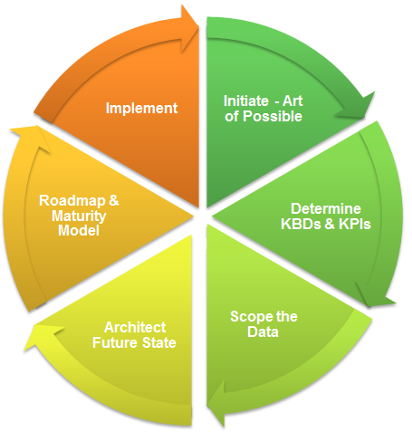
Phase 4 – Develop a target technology stack and architecture
Scope NFRs
Develop tech portfolio
Design platform
Identify non functional requirements and required KPIs for technological evaluation
Identify areas of impact
Performance, Location & Latency
Maintainability & Capacity Growth
Availability & Recoverability
Security, Governance & Data Quality
Create an inventory of products in use & evaluate them against requirements.
Extend the list by examining and adding other products to create a tech portfolio
Extend data entity - business functions - application matrix to tech mapping
Scope the viewpoints (IT, App owners, Dev, QA, Business users, Data scientists)
Create diagrams to present the target data architecture from viewpoints
Perform gap analysis to identify conflicts and completeness against requirements
Objective
Define technical platform & architecture
Understand non functional requirements
Determine a technology portfolio
Technical Architecture Document
Baseline and target technical architecture decomposed to technical components
Environments and location diagram with network & communication infra diagram
HW/Network specifications and capacity info with panning process flow
Data migration, security, governance and management process to tech mapping
Dev, QA and deployment process and lifecycle
TCS Confidential

Slide 7
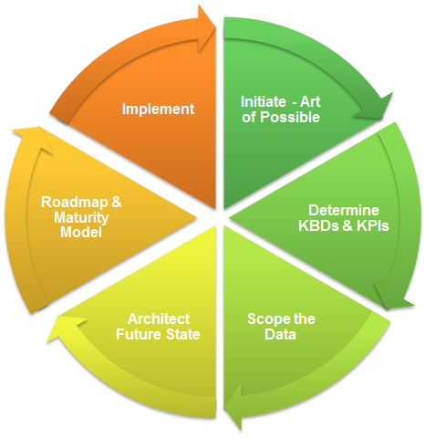
Phase 5 – Determine strategy and delivery vehicles with timeline & cost
Formulate strategy
Create work packages
Implementation planning
Consolidate & integrate the requirements and gaps and perform implementation factor assessment (risk, issues, assumptions, dependencies, actions and impact)
Reorganize the requirement and factors into groups and create an overall strategy
Greenfield implementation
Revolutionary implementation - switch on /switch off
Evolutionary implementation - parallel running or a phased approach
Logically group the activities into work packages and detail them into increments
Assign business value and evaluation criteria to each work package
Performance Evaluation Criteria
Return-on-Investment Criteria
Critical Success Factors
Objective
Create an implementation roadmap
Consolidate the work packages into a roadmap of a timeline of progression
Estimate Resource Requirements and ramp up plan
Prioritize the work packages using a cost/benefit assessment and risk validation
Create work packages of a logical group
Create roadmap of individual work packages in a timeline
Implementation plan with a schedule
Implementation plan
Consolidated requirements, implementation factor assessment and dependencies
Work package portfolio and WBS
Implementation strategy and plan with resource requirements and timelines
TCS Confidential

Slide 8
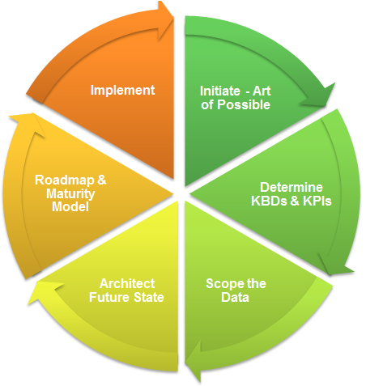
Phase 6 – Successful management of the implementation and development
Manage development
Implement operations
Close project
Identify development methods (generate code, modeling language, tools etc.)
Identify priorities, resolve conflicts and issues, conduct reviews for development teams
Identify deployment issues and make recommendations
Manage risks, access CR and ensure expected value realization
Provide business & IT operational requirements and SLA requirements
Develop business & IT operating models for services.
Publish documentations like run book, developer and user guides etc.
Conduct post-implementation reviews
Publish reviews and close projects
Objective
Execute an implementation program
Operations Manual
Business and IT operating models for the implemented solution
Service Level Agreements
Developers and Users guide
Perform governance functions
Manage Change Requests and Risks
Manage day to day development and Implementation
Closure Report
Post implementation assessment report
TCS Confidential

